Slide 1

Partnership Board
Partnership Board
10am, Friday 27th September 2024
Hybrid meeting (Microsoft Teams and Dean of Guild Room, City Chambers, Edinburgh)

Slide 2

Agenda

Slide 3
Agenda
Order of business
Apologies
Declarations of interest
A1. Appointments
A2. Minutes for approval
A3. Finance Officer’s report
A4. Partnership Director’s update
A5. Go-SEStran
A6. Transport to Healthcare
A7. Annual Report & Business Plan
A8. Regional Transport Strategy Delivery Plan
A9. Date of next meeting - Friday 6th December 2024

Slide 4
1. ORDER OF BUSINESS
2. APOLOGIES
3. DECLARATIONS OF INTEREST

Slide 5
A1: Appointments

Slide 6

Appointments
The Partnership Board are requested to appoint:
Chairperson
Deputy Chairperson(s)

Slide 7
A2: Minutes of Previous Meetings

Slide 8
 | For Approval
 | (a) Partnership Board – Friday 21st June 2024
 | (b) Performance and Audit Committee – 13th September 2024

Slide 9
A3: Finance Officer’s Report
Report by Richard Lloyd-Bithell, Treasurer/Iain Shaw

Slide 10
Finance Officer’s Report
Report presents first update on the financial performance of the Partnership’s Core and Projects budgets for 2024/25 for noting.
Report was reviewed by Performance and Audit Committee on 13th September 2024.
Core expenditure is forecast to be £29,000 greater than budget;
Variance is principally due to the reduction of £39,000 in Scottish Government grant;
Partly offset by reduced office rental costs of £7,000 and employee costs forecast to be less than less than budget by £3,000.
Projects expenditure – including the People and Places Programme - is forecast to be within budget.
Projects budget slippage of £168,000 from 2023/24 is forecast to be fully spent in 2024/25.
The Partnership’s unallocated General Reserve of £130,000 will reduce by £29,000 to £101,000 to meet the Core budget shortfall.

Slide 11
A4: Partnership Director’s Update
Presentation by Brian Butler

Slide 12

Dark clouds….
Block Grant down 5% this year – uncertainty for 2025/26
In-year expenditure controls
Regional Bus Partnership - £423m unspent but scheme paused
Concessionary bus fares under threat
Peak rail fare scheme ended
Active Travel infrastructure – budget reduced by at least £23m this year
People and Place Programme – next year will be expanded to include sustainable travel and community organisations – but will funding be increased to suit?
Perceived slow down in innovation funding

Slide 13

But it’s not all gloom and doom….
Confidence in the regional model
UK government commitment to sustainable transport and the environment
Transport governance talks with Transport Scotland, CoSLA and SCOTS
Innovation funding
SEStran Funding workstream

Slide 14

Electric Vehicle Charging Infrastructure…aims
To explore the benefits of taking a collaborative approach to the procurement of electric vehicle charging infrastructure
In order to allow LAs to make an informed decision on collaborative procurement relative to taking a unilateral approach
And to develop a standard range of project and contract documentation in order to eliminate duplication and minimise costs
Partners: all local authorities in SEStran and SWestrans regions – except ELC; working with Transport Scotland, the Scottish Futures Trust, and Scotland Excel

Slide 15

Electric Vehicle Charging Infrastructure…next steps
Programme
Governance: Oversight Group – Steering Group – Working Group
Reps from all LAs plus TS, SFT, SE, SEStran and SWestrans
Supported by Urban Foresight
Process
CEC leading on procurement process and timelines, and producing contract documentation
Draft proposal now tabled for consideration by all partners
Will be subject to much discussion and negotiation over coming weeks
Each LA will then decide how to proceed
Oversight Group will meet to discuss then submit papers to relevant Council committees
MEMBERS
RTP

Slide 16

RTP Chairs / Transport Scotland
Government Commitment
20% reduction in car kms….will be 20% reduction in car use
For rural areas – conversion to zero emission cars will count
Bus
Regional Bus Strategy
Under-22s Concessionary Fares and Network Support Grant
Bus Futures Paper
Costs of public transport v costs of private motoring – fuel duty!
Smart ticketing
2019 Act Guidance
Bus Open Data

Slide 17


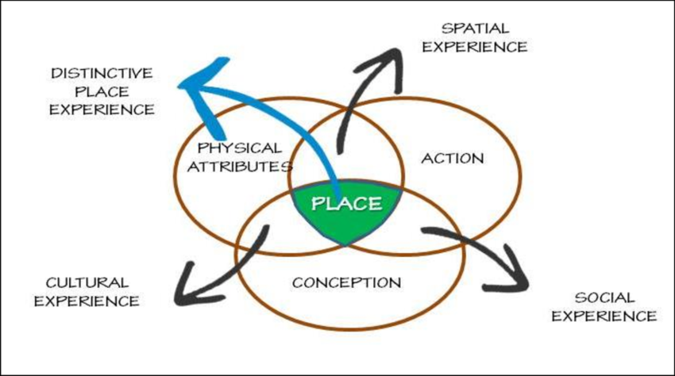

And the rest….
We didn’t receive any tender returns for our Legal Services contract.
The current contract with Anderson Strathern will be extended and we will re-tender with a slightly modified specification.
Our new Marketing and Communications Officer, Sarah Junik, starts on 30th September.
Sarah has a fantastic mix of skills and experience, and will hit the ground running.
Watch this space for a marked improvement in our output!
We held a successful workshop attended by Transport Scotland and all of our local authority partners to kick off our 5 year People and Place delivery plan
We are also proposing that our management of the People and Place Plan should be focus of this year’s Internal Audit.
In response to feedback from Transport Scotland, we held a well attended community workshop, to build the socio-economic business case for a new railway station at Newburgh.
We had representation from local politicians, community groups, and both the private and public sectors.

Slide 18
A5: GoSEStran
Report by Rebecca Smith

Slide 19

GoSEStran go/no go criteria
  Agreed criteria to continue with GoSEStran at March 2024 board:
  Long term funding committed (at least 3 years)
  Successfully concluded procurement exercise to confirm future partners
  Service Level Agreement (SLA) in place with Tactran and other Integrated Mobility Partnership (IMPs) partners to confirm responsibilities, including project management

Slide 20

GoSEStran progress since March 2024
  Progress since March:
  Funding: £242,000 of funding is currently in place
  Procurement: Ongoing with support of Innovate UK, due to compete October
  Partnership: SLA in place with Tactran providing an IMPs project manager

Slide 21
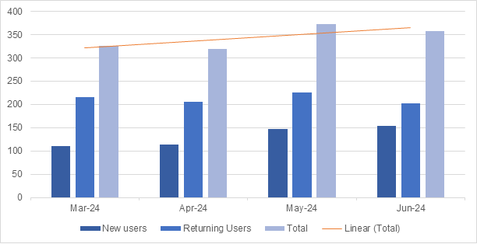
New outcomes for IMPs
  Encourage car drivers to use sustainable modes (to support 20% car km reduction target, those drivers whose trips contribute most to mileage total; to support air quality objectives, car trips in AQMAs)
  Help non car owners (and those in our least affluent areas) be aware of and navigate multi-modal travel options to access jobs, education and services
  Enable people with mobility difficulties to navigate our transport networks.
Users of GOSEStran (Mar – Jun 2024)
Stats show users are still around 300 per month but there is a mix of new and returning users.

Slide 22
GoSEStran risks and opportunities
  Key risks of continuing GoSEStran
  Confirmation of further funding from Transport Scotland
  Reputational risk if service is poor
  Key opportunities of continuing GoSEStran
  Recent Transport Scotland report and the MaaS roadmap indicate value in national solution
  SEStran remaining at the forefront of MaaS in Scotland
  Incorporating VoyagAR into the final product
  Continuity of the app for users and retaining user confidence

Slide 23
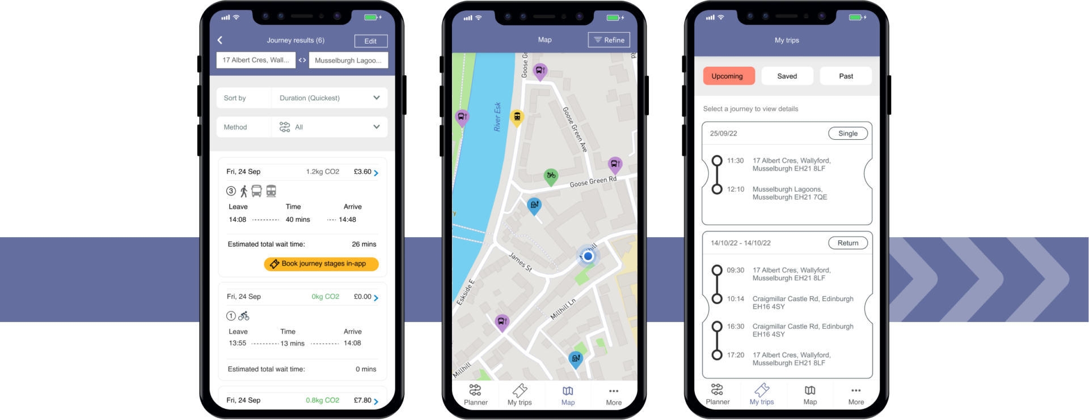
GoSEStran recommendations
  It is recommended that the Board:
  Agrees to the continuation of GoSEStran as part of the Integrated Mobility Partnership due to the significant progress on funding made as outlined in this report, and achieving two of the three criteria presented at the March board
  Authorises the Partnership Director to enter into such contractual agreements as are required to progress the GoSEStran and VoyagAR projects to their fullest extent possible within available funding levels
  Agree to receive regular progress updates via the Projects Update at Performance and Audit Committee, with such Board reporting as is necessary as the projects progress

Slide 24
Transport To Healthcare
Update by Keith Fisken

Slide 25
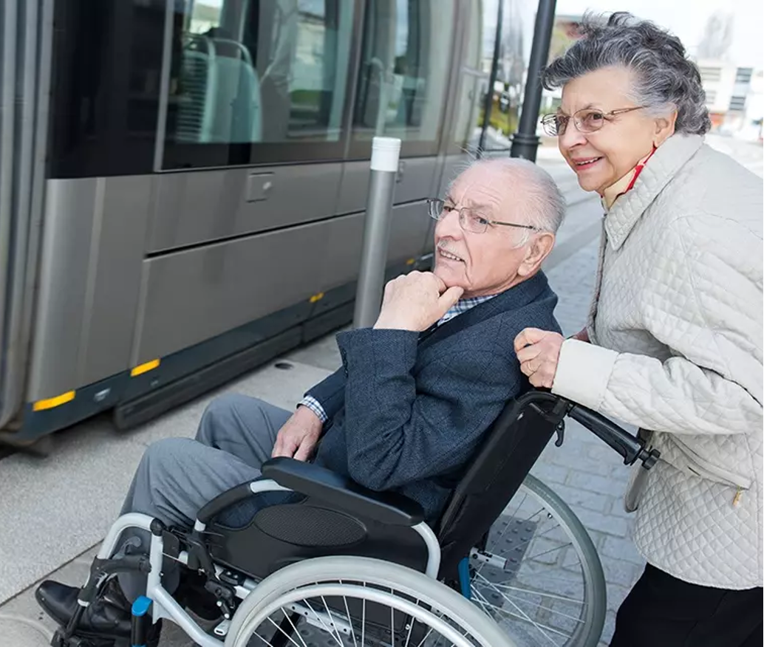
Background
Transport to health is essential for connecting Scots with healthcare, from GP appointments to hospital care.
In 2019, the Mobility and Access Committee for Scotland (MACS), in collaboration with Transport Scotland, produced the MACS Report: Transport to Health and Social Care.
The Transport (Scotland) Act 2019 reinforced key aspects of transport to health services.
The Primary Health Directorate and Transport Scotland published a draft Transport to Health Delivery Plan.
This draft was presented at the SEStran board meeting in December 2023.
Notes:
Transport to health is a key service, connecting Scots with healthcare, from day-to-day appointments at the GP to hospital care. Work in this area is ongoing, and there are pockets of excellence, amid areas underserved.
In 2019, the Mobility and Access Committee, working with Transport Scotland, produced MACS Report: Transport to Health and Social Care.
This was strengthened by implementation last autumn of parts of the Transport (Scotland) Act 2019, which dealt specifically with Transport to Health . Unfortunately, however, the pandemic and ever-tightening budget, both in the health service and among transport operators, have meant that further progress from this point has often been slow and highly varied. Momentum has picked up again after the Primary Health Directorate and Transport Scotland published their Transport to Health Delivery Plan draft. The draft puts an obligation on both health boards and regional transport partnerships to work together when considering transport to health.

Slide 26
We have engaged with...
NHS Assure
Voluntary Health Scotland
Scottish Ambulance Service
Community Transport Association
NHS Borders
Children's Health Scotland
NHS Forth Valley
NHS Lothian
Public Health Scotland
NHS Fife
SEStran Transport to Health Learning Network

Slide 27
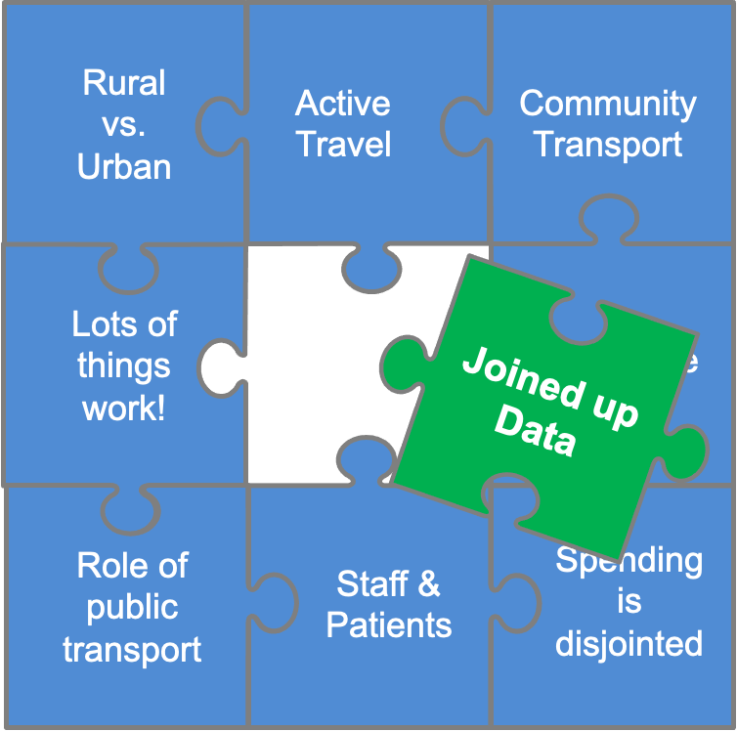
Common themes & future approach
Health care is a huge trip generator
Huge impacts for – patients and health providers
How do we create links?
Understand the scale
Understand the opportunity
Introducing the team from Urban Tide
Notes:
A prevailing theme, particularly relevant in rural communities, is the quality of public transport. In order to be a reliable option for patients, visitors, and staff accessing healthcare sites, public transport must be affordable, available, and accessible.
Active travel, including walking, wheeling, and cycling, was mentioned as a pillar of transport to health. There was a focus on the role of active travel in staff accessing sites, improving their own health and well-being, and alleviating pressure on facilities like car parks. Furthermore, the role of active travel activity in improving strength and aerobic health was mentioned in relation to preventive improvements in health and improved recovery times after major medical interventions, like surgery.
Spend on transport to health is disjointed, accounted for differently even within health boards, and not delivering, in many cases, as good a service as possible. It is also worth considering that local authorities, in many cases, are subsidizing public transport options that cover health facilities, further costs to consider. Perhaps the most obvious example of spend is on taxis, being used across the region where more organized transport services are not meeting the challenge in the area, or in fact do not exist at all.
The role of community transport was mentioned by a number of health boards as a key ally in delivering transport to health, though the point was made that some CT services, particularly those staffed by volunteers, do not match up with times kept by clinics, surgeons, and appointments.
Across the board, there was an acknowledgment that there are pockets of excellence: pilots and projects delivering a better service for the health board, the patient, and the community. That said, these pockets of innovation are out of step with the general principle of the national health service; a service available to all, where they live.

Slide 28
Urban Tide Presentation

Slide 29
BUSINESS PLAN & ANNUAL REPORT
Update by Keith Fisken

Slide 30
Integrated End to End Planning Process
Regional Transport Strategy
12-Month Business Plan
New Project & Strategy Development (Initiation)
Monitoring and Reporting
Annual Report

Slide 31
2025/26 Timeline
Business Plan
October – SEStran Officers to develop high-level business plan draft
November to December – P&A Working Group to review and provide feedback to officers
January to February 2025 – refine and produce a final draft for P&A review
March 2025 – Present to Partnership Board for approval
2024/25 Annual Report
February 2025 – Produce first draft for review by P&A
March 2025 – Present to Partnership Board for comment

Slide 32
Regional Transport Strategy Delivery Plan
Update by Keith Fisken

Slide 33
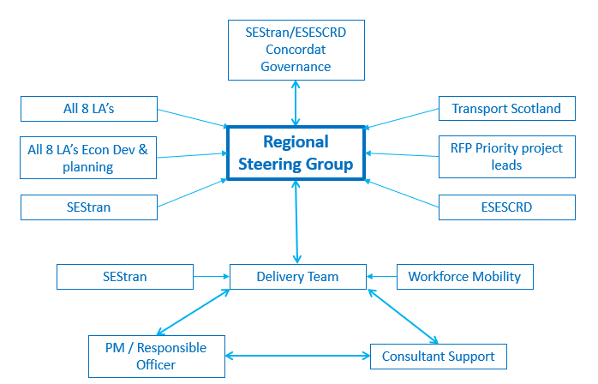
Vision and Objectives
The Regional Transport Strategy Delivery Plan will provide a mechanism to assess and prioritise regional projects that are required over the next ten years.
It will realise the ambitions of the Regional Transport Strategy and support the economic and net-zero ambitions of the Regional Prosperity Framework.
Identifies strategically important infrastructure and integration projects
Identify priority projects to be delivered in the next 10 years.
Identify priority projects to be developed further.
Monitoring & Evaluation Plan
Maintenance of an up-to-date matrix of projects in the region

Slide 34
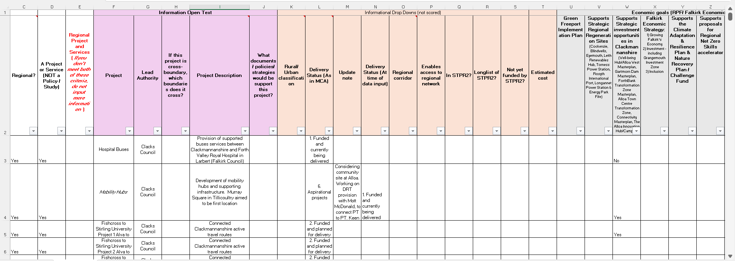
Regional Transport Strategy Delivery Plan

Slide 35
A9: DATE OF THE NEXT MEETING:
10:00am on Friday 6th December 2024

