Slide 1

LOGISTICS AND FREIGHT FORUM
21st NOVEMBER 2024
Online

Slide 2
AGENDA
Welcome & Introductions – Keith Fisken (Chair)
Regional Transport Strategy – Actions for Freight – Update by Rachael Murphy
Horizon Fusion Project – Update by Keith Fisken
Sustainable Aviation Technologies for Freight & Logistics Sectors – Lukas Princ, HiTrans
Towards Zero Emission HGVs – Call to Action
Date of next meeting – to be confirmed

Slide 3
MINUTE OF THE MEETING ON 30TH MAY 2024 AND MATTERS ARISING

Slide 4
Actions from 30TH May 2024
Space for Cargo Bike for last-mile logistics
KF will share the study with local authority planners and transportation employees within SEStran region.
UK Cargo Bike Summit Update
BHJ to let Forum members know the date of the next Cargo Bike Summit meeting in 2025.
Suggestions for topics at future meetings
Any Forum members who have suggestions for topics for discussion or would like to present a topic at future meetings, please contact Keith Fisken – keith.fisken@sestran.gov.uk
For Approval

Slide 5
REGIONAL TRANSPORT STRATEGY
ACTIONS FOR FREIGHT
UPDATE BY RACHAEL MURPHY

Slide 6
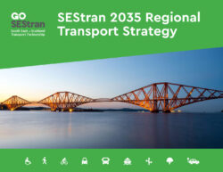
Regional Transport Strategy
Strategy Objective 1: Transitioning to a sustainable, post-carbon transport system
Strategy Objective 2: Facilitating healthier travel options
Strategy Objective 3: Transforming public transport connectivity and access across the region
Strategy Objective 4: Supporting safe, sustainable and efficient movement of people and freight across the region

Slide 7
Freight challenges identified in RTS
In places, peak period, commercial, vehicle-based journey times can routinely be much longer than off-peak: congestion causes delays to freight vehicles, which increases supply chain costs and reduces productivity
Peak period, commercial, vehicle-based journey times can be much more variable than off-peak: unreliable journey times affect the ability to deliver a ‘just in time’ service, affecting supply chains across the economy
Cost and practicality of rail freight prevents widespread use: the fixed nature of the rail network makes it impractical for some freight movements
Commercial vehicle drivers have limited options for secure parking and rest: whilst rest facilities are available, these are insufficient and not always sited in the most convenient locations
Commercial vehicles are currently reliant on fossil fuels in the absence of viable/cost-effective alternatives: ULEV technology has yet to provide a viable alternative for commercial vehicles, affecting the ability to decarbonise the sector
Direct sea-based international connectivity is poor: there is no ferry service between Scotland and the EU since the withdrawal of the DFDS freight ferry between Rosyth and Zeebrugge in 2018

Slide 8
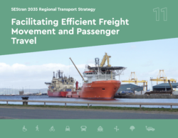
Passenger and Freight policies
a) The RTS supports targeted infrastructure investment, including new road links or increased road and junction capacity: only in line with the Transport Scotland sustainable travel and investment hierarchies and when all other avenues are exhausted or where significant economic opportunities would otherwise not be realised or are being severely impacted under the status quo where bus priority and/or active travel is integral where appropriate
b) The transport network should be robust and resilient to adapt to the impacts of climate change, with suitable diversionary routes in place for instances when key primary routes are required to close temporarily
c) Opportunities should be sought to reestablish direct passenger and freight ferry links with Europe
d) The RTS supports maximising international air linkages through Edinburgh Airport – including freight

Slide 9
Freight policies
Additional locations for secure, commercial vehicle driver rest areas on the strategic road network should be investigated – STPR2
Freight Consolidation Centres should be implemented at key locations on the strategic network, including potentially on the A720 Edinburgh City Bypass and Leith Port
Micro-consolidation centres should be implemented in conjunction with multi-modal mobility hubs and supported by sustainable ‘first and last mile’ logistics, including cycle logistics and electric vans
Opportunities should be sought to enhance gauge clearances on the rail network to enable a wider range of freight wagons and containers to operate on the region’s network, and for the number of rail freight services to be increased accordingly
The RTS seeks the implementation of loops and other appropriate infrastructure that will enable additional train paths for freight services to be provided in the region
Where appropriate, funding support should be used to implement new or enhanced rail freight services in the region
Opportunities for innovative passenger train forming which incorporates the ability to carry freight should be explored
Beneficial innovation and automation should be used to increase the efficiency of freight and logistics networks across the region

Slide 10
Regional Transport Strategy Delivery Plan
RTS Delivery Plan Vision
The Regional Transport Strategy Delivery Plan will provide a mechanism to assess and prioritise regional projects that are required over the next ten years to realise the ambitions of the Regional Transport Strategy to support the economic and net-zero ambitions of the Regional Prosperity Framework.
RTS Delivery Plan Objectives
Identifies strategically important infrastructure and integration projects
Identify priority projects to be delivered in the next 10 years.
Identify priority projects to be developed further.
Monitoring & Evaluation Plan
Maintenance of an up-to-date matrix of projects in the region

Slide 11
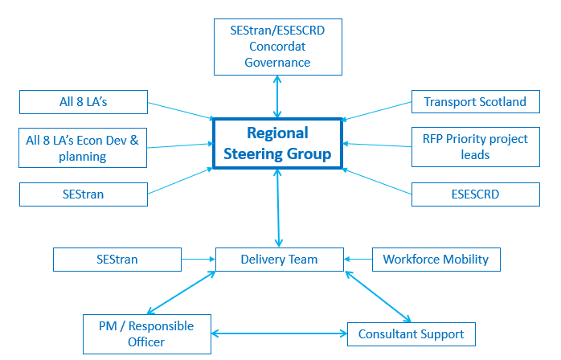
Regional Transport Strategy Delivery Plan

Slide 12
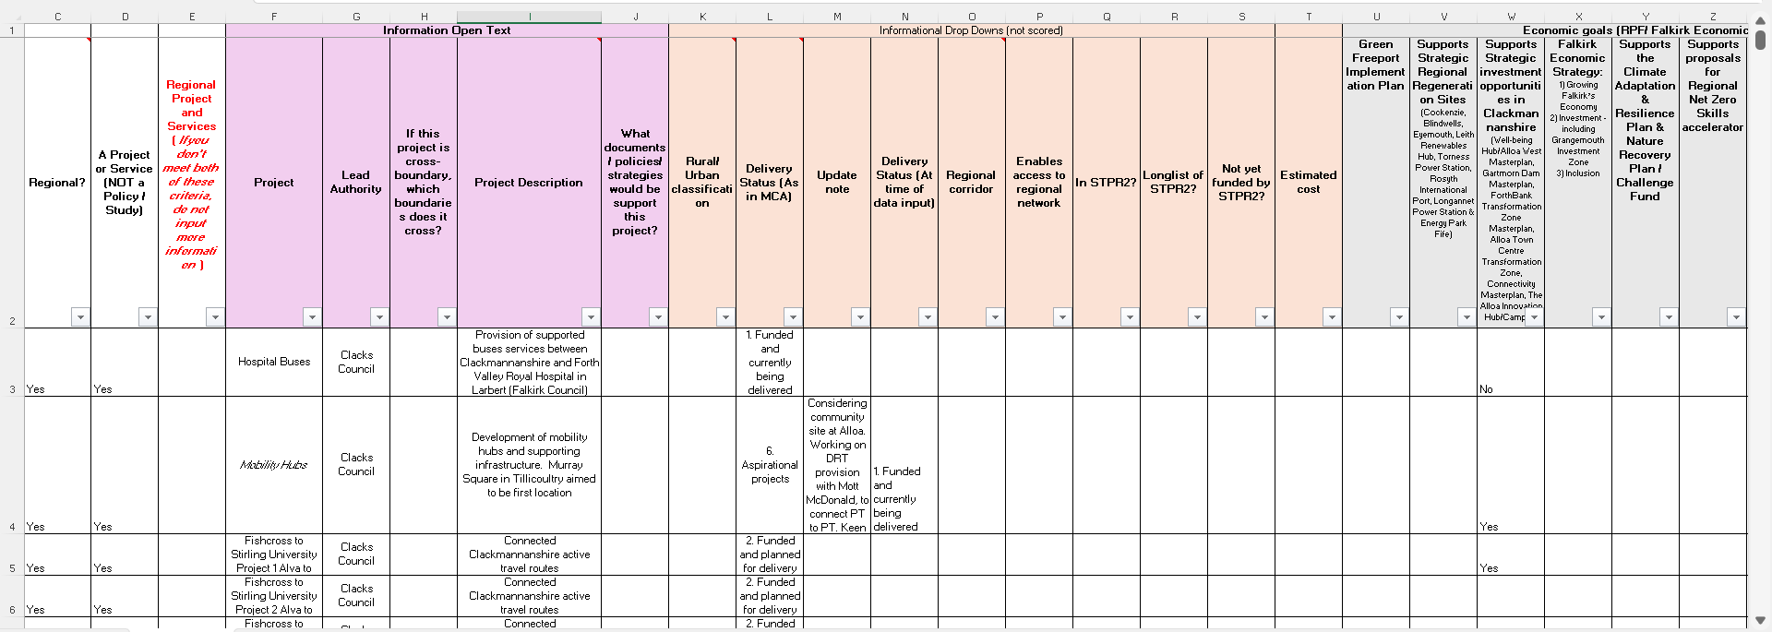
Regional Transport Strategy Delivery Plan

Slide 13
What next?

Slide 14
FUSION - Freight & Urban System Integration for Optimised Networks
Keith Fisken
Notes:
Do little intro here

Slide 15
FUSION
Noun
The process or result of joining two or more things together to form a single entity
A fusion of different qualities, ideas, or things is something new that is created by joining them together

Slide 16
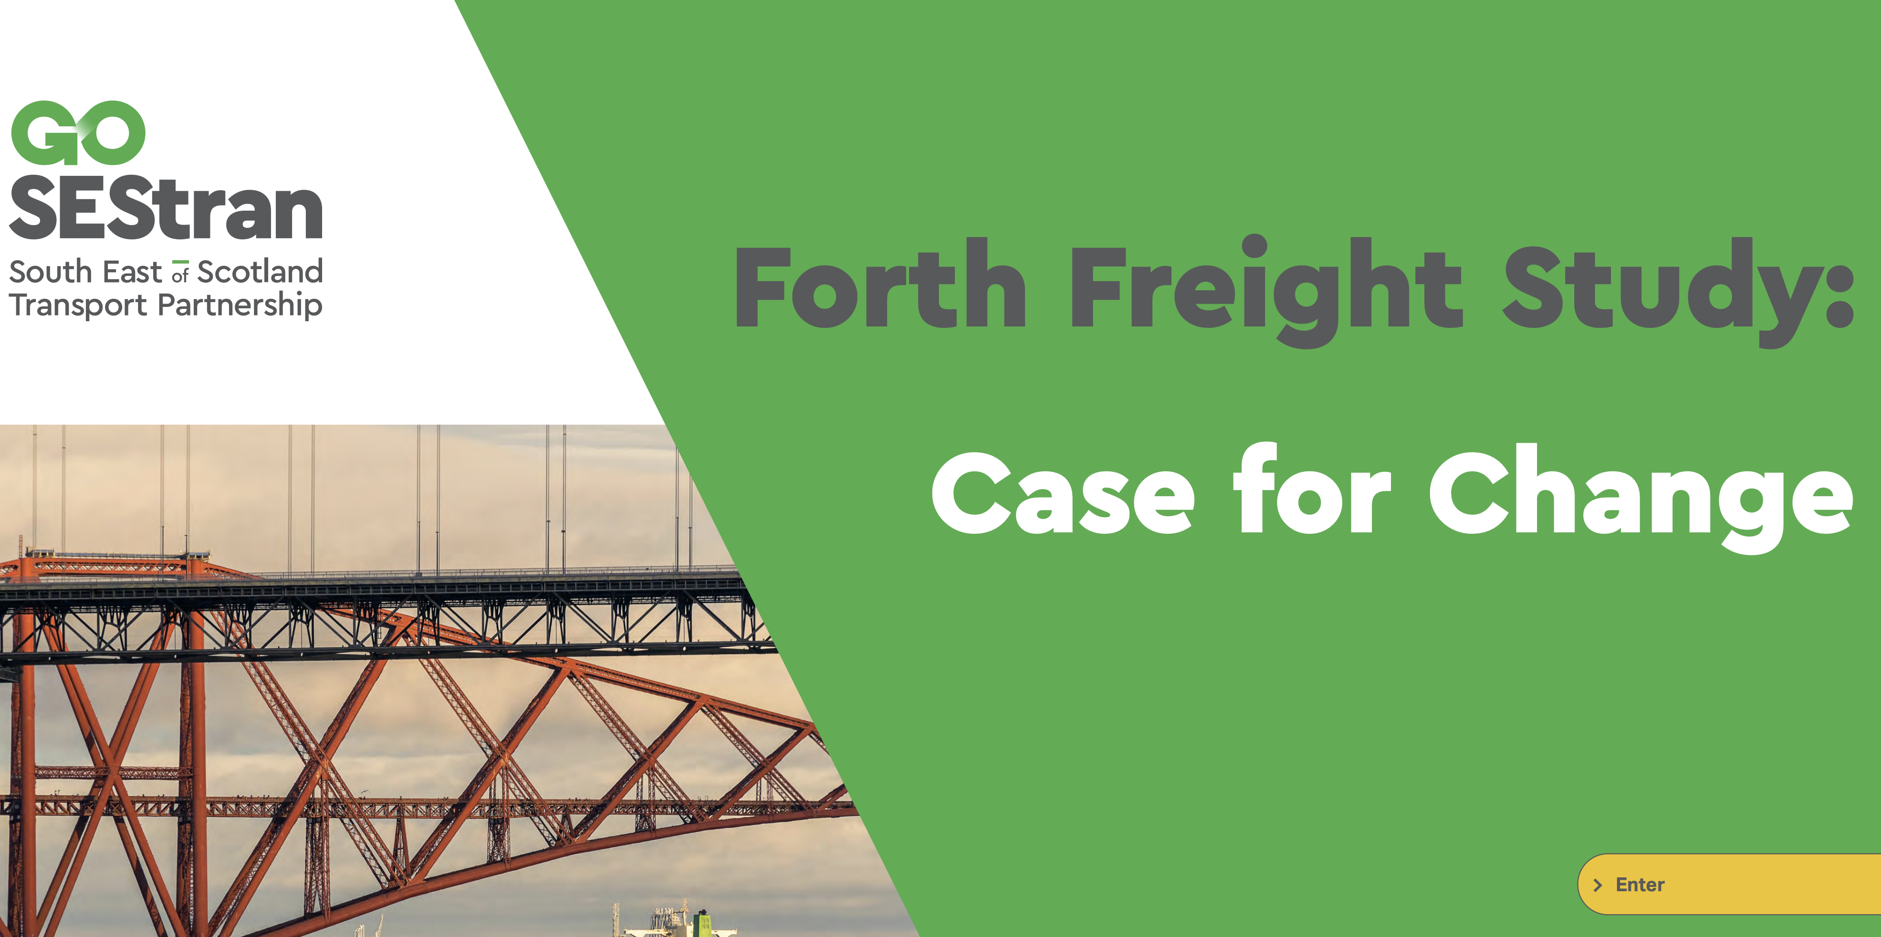
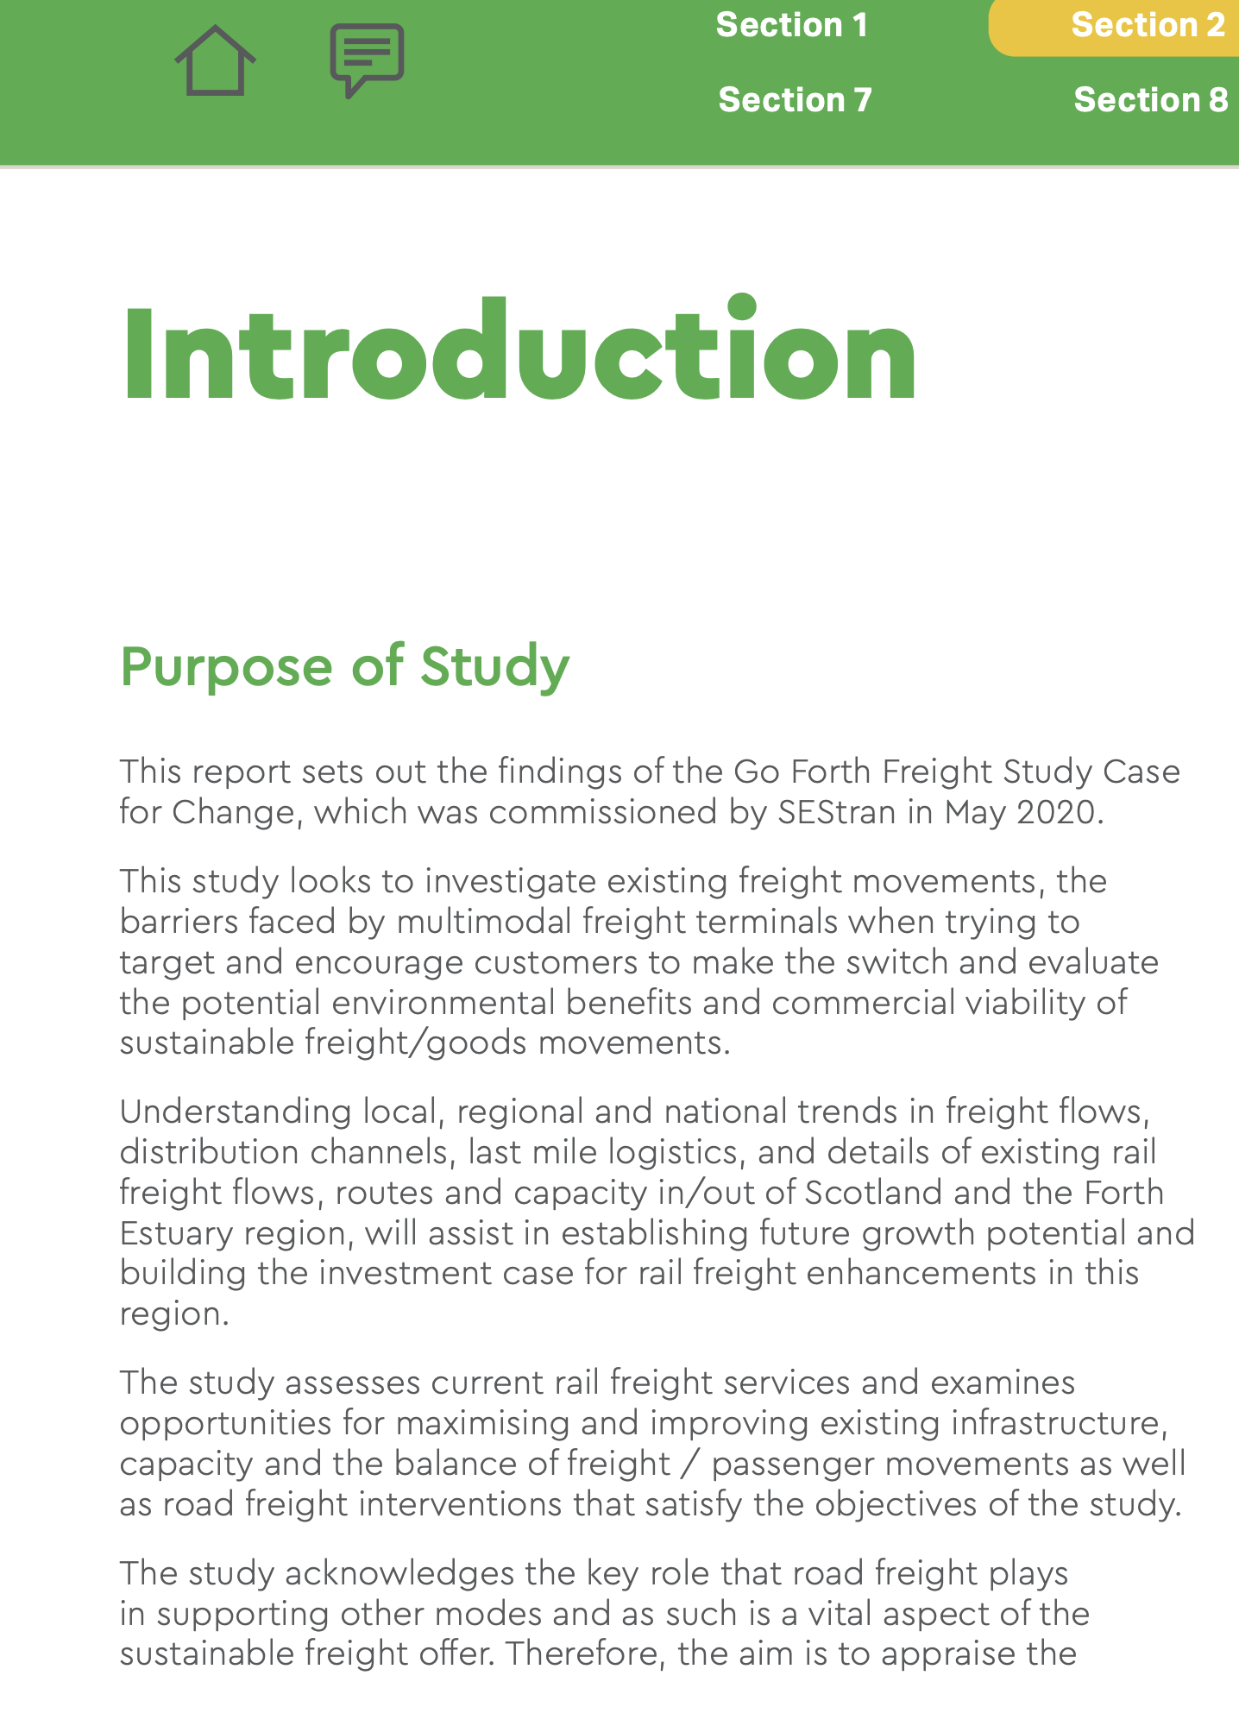
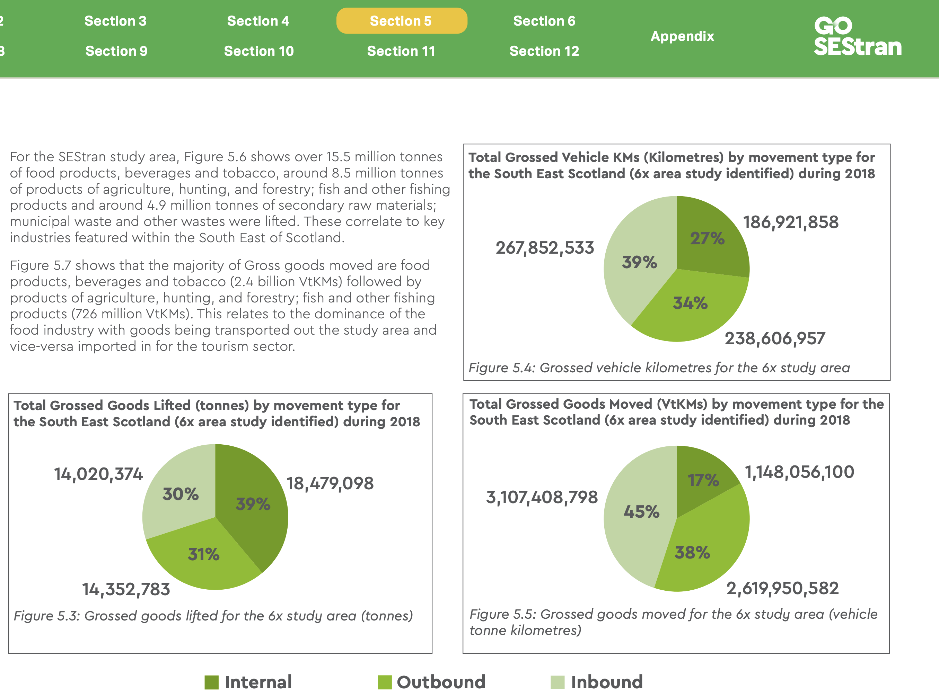
Where we came from
Freight does not operate in isolation
”Freight cannot work from home”
Professor Phillip Greening Herriott Watt University
Regional freight study work funded by Transport Scotland
Initial business cases developed for 3 potential regional freight options
Support from City of Edinburgh and Edinburgh Trams
How do we progress…?

Slide 17
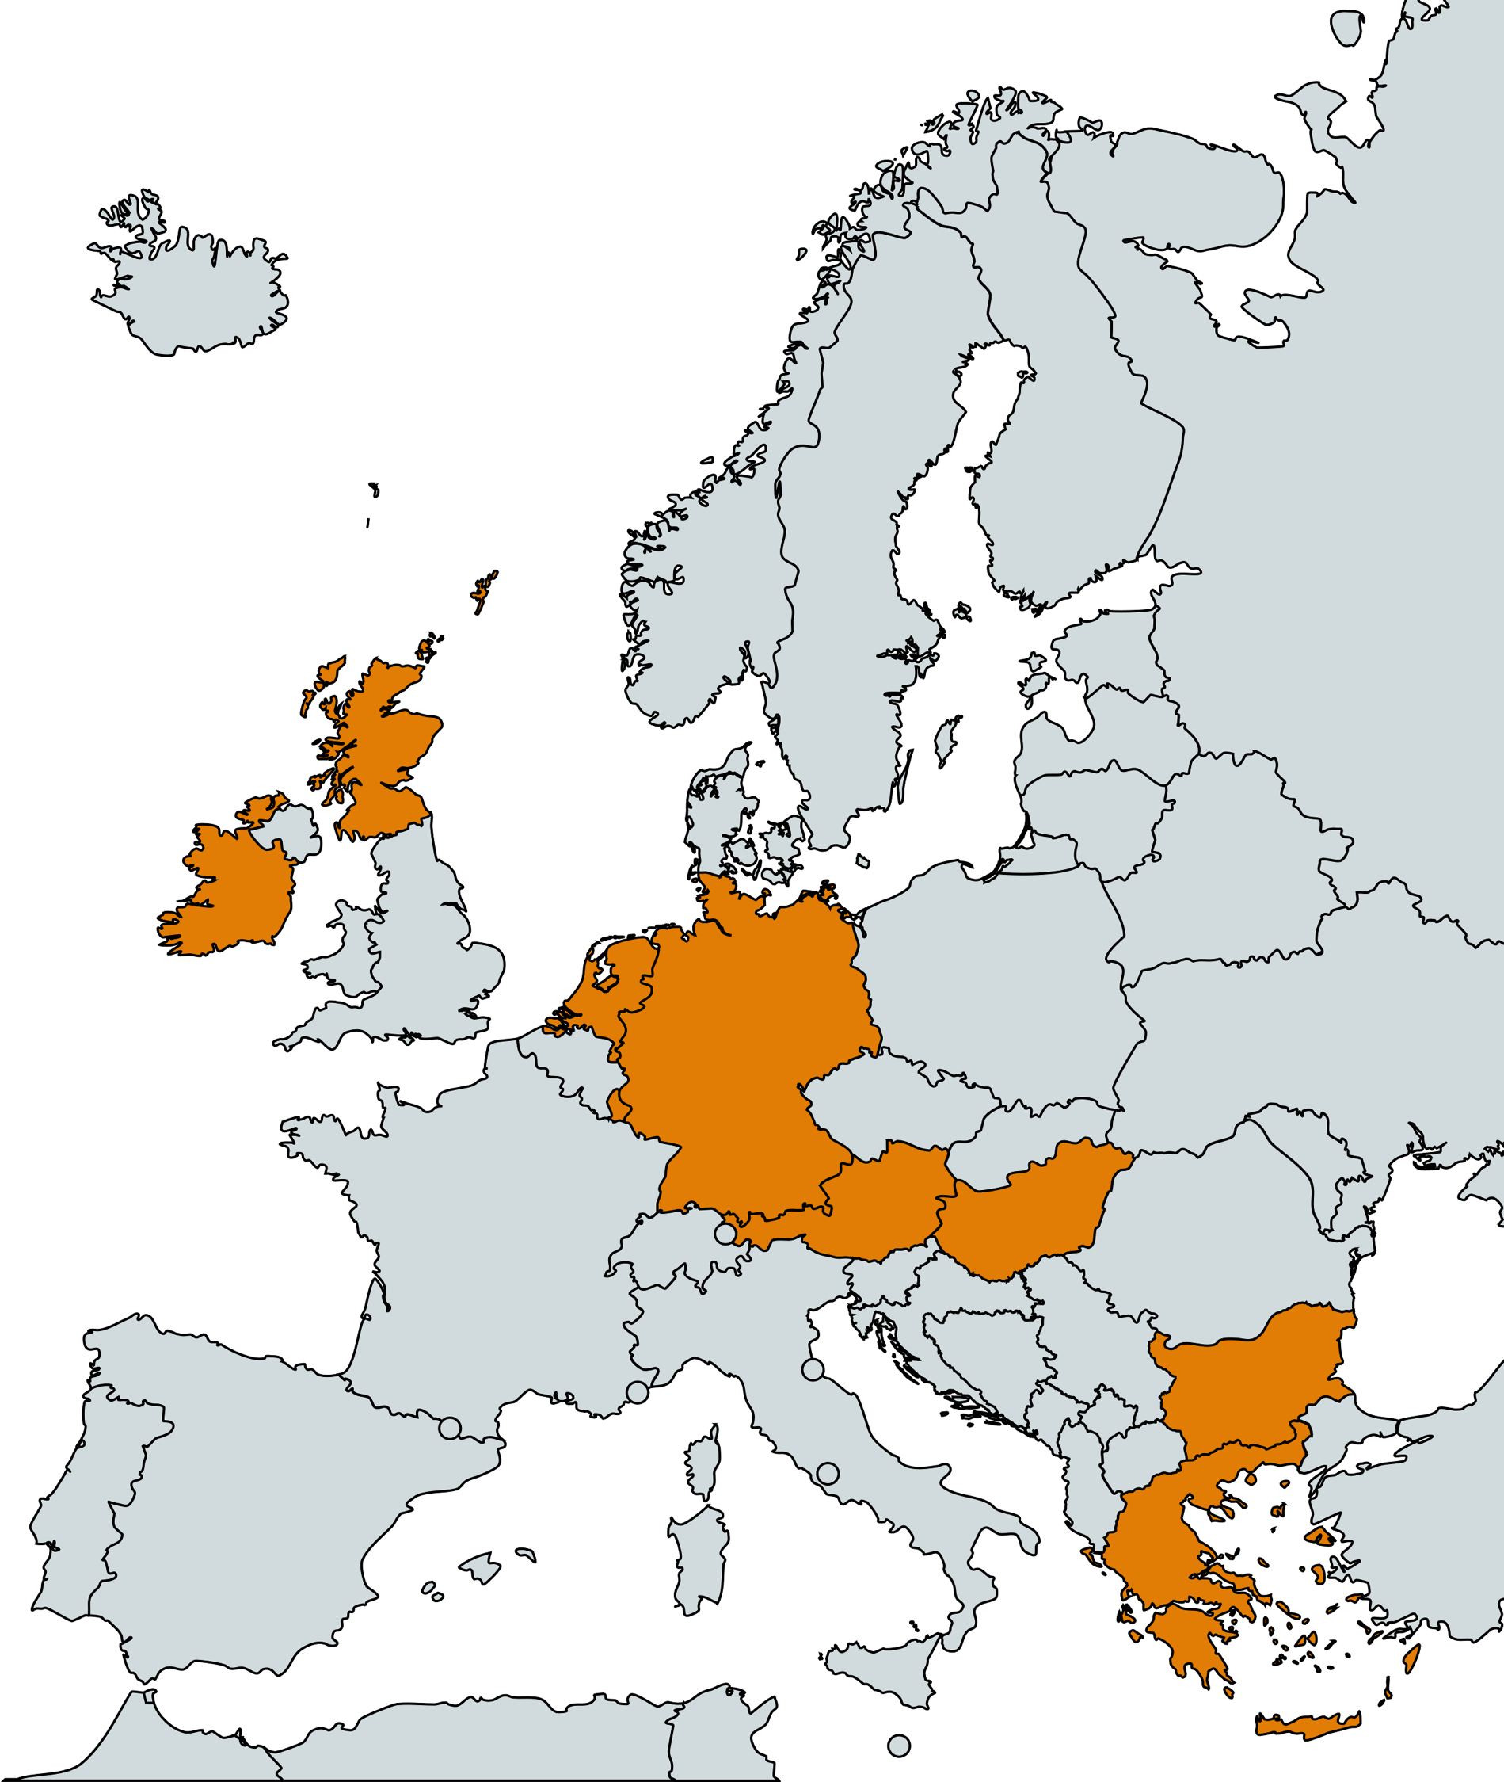
FUSION Partners
15 partners from across 9 countries
5 million Euro bid into HORIZON Europe
Mix of academic, public authorities and industry
Research, concept development, modelling and real-world testing
Vision
Optimise urban transport networks through innovative synchro- and co-modality approaches, integrating complementary modes of transport to enhance efficiency and sustainability

Slide 18
Ambitions and Considerations
Create New Network Capability
Modal Shift – support policy ambition
Support Spatial Planning
Ensure Network Security
New Business Opportunity
Reduce Congestion
Manage Complexity & Change
Maintain/Increase Operational Efficiency
Develop New Systems

Slide 19
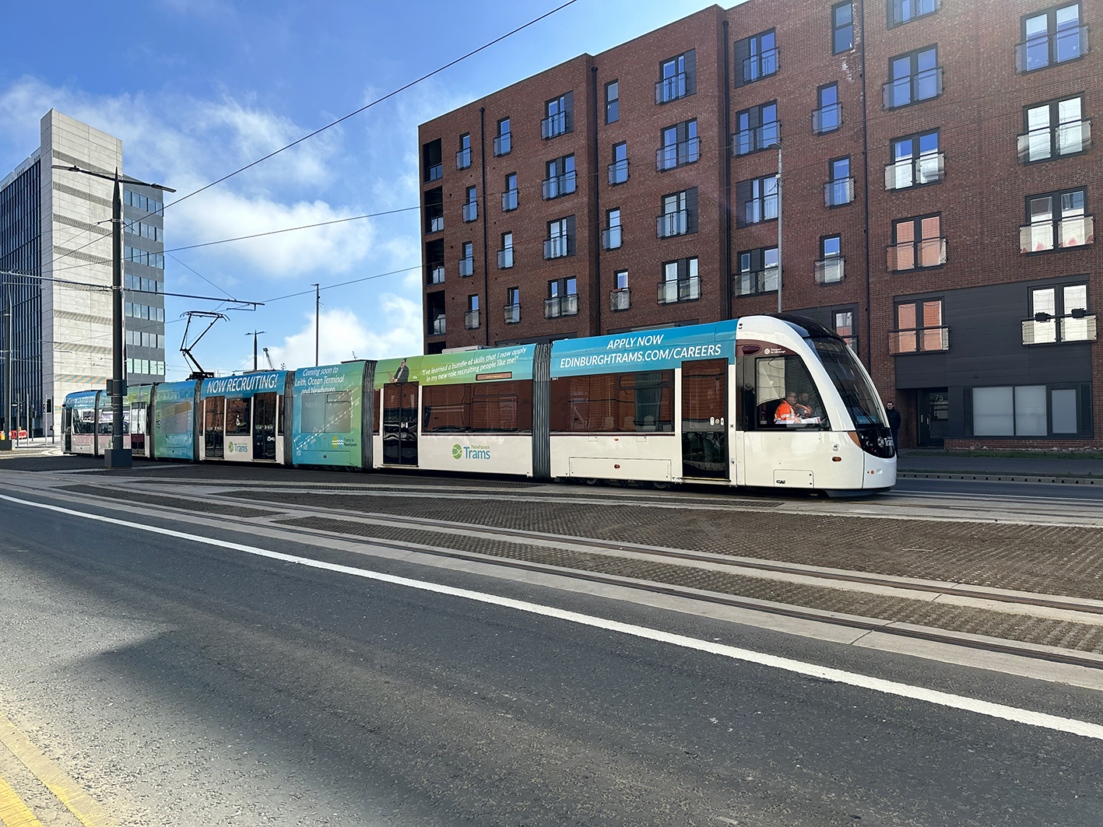
Edinburgh Tram Pilot
Filling a tram to 50% of its internal volume is equivalent to 14 Long Wheelbase Transit full vans
Consolidation of freight at any point in the network could inspire more action elsewhere
Increasing cycle logistics opportunities in the city
Alternative fuelled road freight won’t reduce traffic and the increased weight of vehicles would be damaging to road infrastructure
Maximising the asset could support the business case for future tram extension

Slide 20
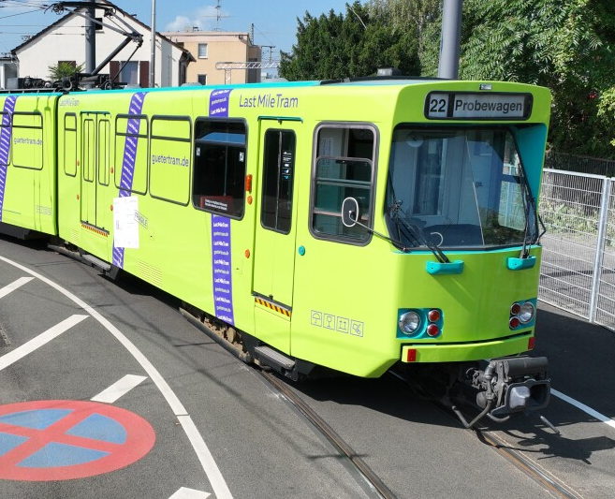
We are not alone
Amazon in Germany
The pilot project is part of the ‘LastMileTram RheinMain V’ research project
Partnership between Frankfurt University of Applied Sciences and Amazon Transportation Services (ATS)/ Logistics (AMZL) teams.

Slide 21

Next steps
Bid submitted in September 2024 by led authority (Edinburgh Napier University)
Feedback to be received January 2025 with notification of award if successful
Work would commence March/April 2025 subject to contract agreements being in place
Project will run for 4 years

Slide 22
Sustainable Aviation Technologies for Freight and Logistics Sectors
BY LUKAS PRINC, HITRANS

Slide 23



Sustainable Aviation
Technologies for Freight and Logistics Sectors
Lukas Princ
SATE Business Manager

Slide 24


Airlander
Freight and logistics
Highlands and Islands of Scotland

Slide 25
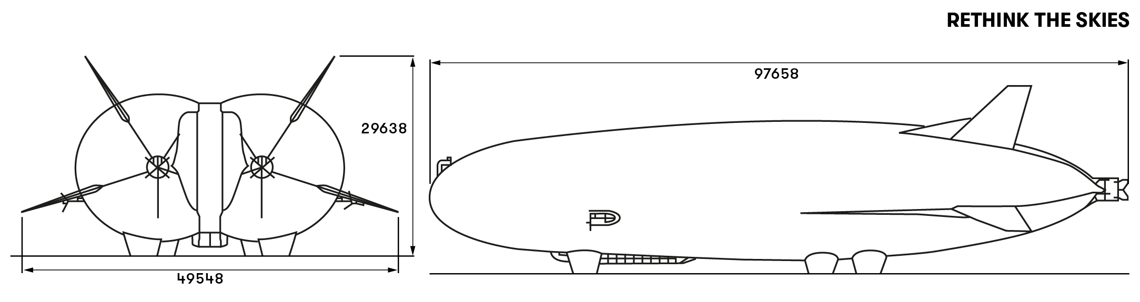
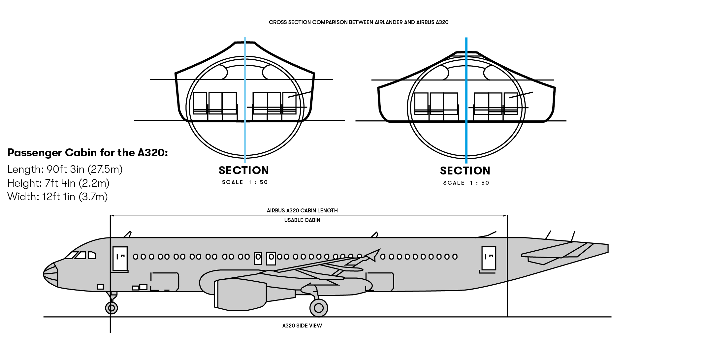
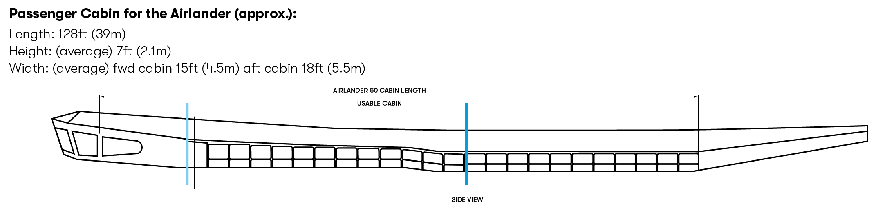

General cabin characteristics
Passenger Cabin for Mobility Variant Dimensions (approx.)
Length: 128ft (39m)
Height: 7ft (2.1m) average
Width: 16ft (5m) average
Floor Area: 2,050ft² (195m²)
Volume: 13,760ft³ (390m³)
Luggage Storage Area: 425ft³ (12m³)
This document and the data it contains are the property of Hybrid Air Vehicles and may be confidential. They are subject to restrictions on their use. All use other than that permitted in writing by Hybrid Air Vehicles is prohibited.
3
3

Slide 26
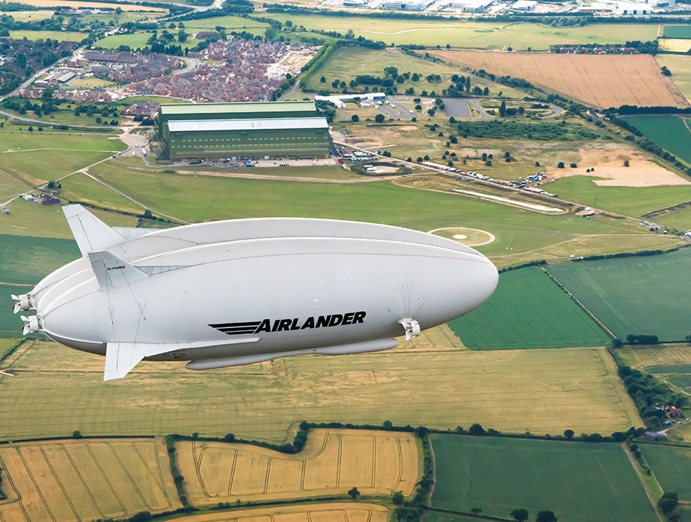
Brief timeline
Maiden flight of prototype 2012 – Lakehurst NJ
2016/17 – UK flight test programme
2024 – production location announced
and type certification of production variant launched
Scheduled 2027 – FF production variant
Scheduled 2028 – Type certificate
Scheduled 2030 – First electric powertrain available
This document and the data it contains are the property of Hybrid Air Vehicles and may be confidential. They are subject to restrictions on their use. All use other than that permitted in writing by Hybrid Air Vehicles is prohibited.
4

Slide 27

Background - 2023 Study - Working group participants
Highlands & Islands Airports (HIAL)
Hybrid Air Vehicles (HAV)
Orkney Islands Council (OIC)
Highlands & Islands Transport partnership (HITRANS)
Highlands and Islands Enterprise (HIE)
AECOM (sub-contracted to perform on-site survey work at representative airports).
Loganair
Study was partially funded via SATE

Slide 28
Freight characteristics
10 tonne payload – no CofG limitations
Large cabin – easy to load and compatible with ULD’s and vehicle carriage with rear ramp
Can be configured in ‘combi’ configuration
No requirement for traditional airfield infrastructure – can deliver directly to a site adjacent to the origin / destination
Water landing capability ideal for fresh produce applications

Slide 29

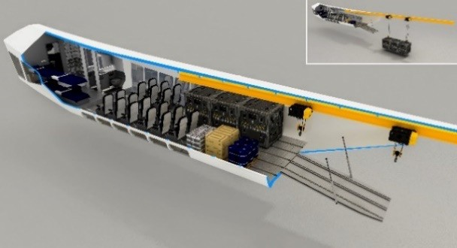
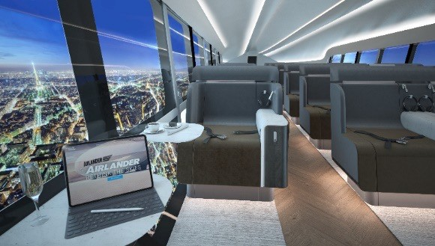
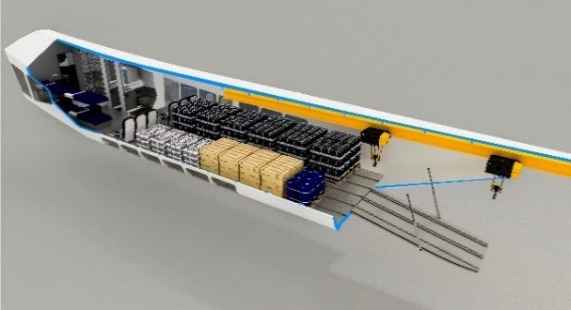
‘Combi’ / utility configurations
The utility module can be short cabin or long cabin variant
Shown left is the short cabin variant
Long cabin variant has double the space and therefore double the seats and freight area
Utility concept (Combi layout of passengers and freight, with rear loading ramp for freight)
This document and the data it contains are the property of Hybrid Air Vehicles and may be confidential. They are subject to restrictions on their use. All use
other than that permitted in writing by Hybrid Air Vehicles is prohibited.

Slide 30
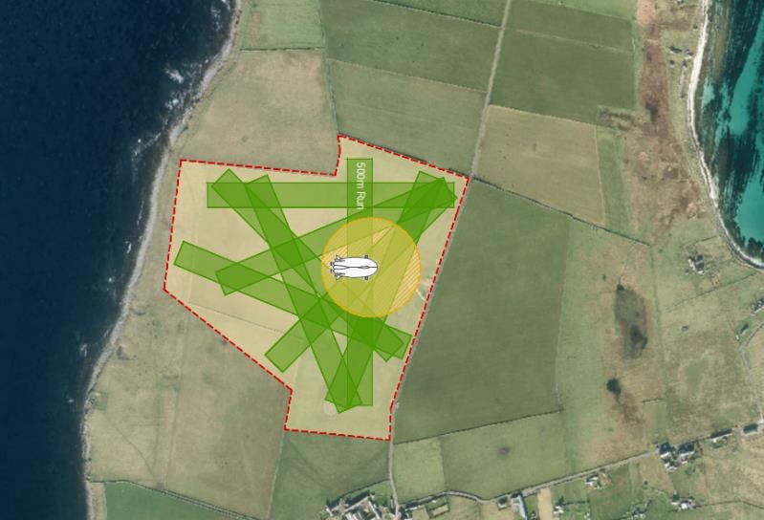
Huge operational flexibility – Low infrastructure
This document and the data it contains are the property of Hybrid Air Vehicles and may be confidential. They are subject to restrictions on their use. All use
other than that permitted in writing by Hybrid Air Vehicles is prohibited.

Slide 31
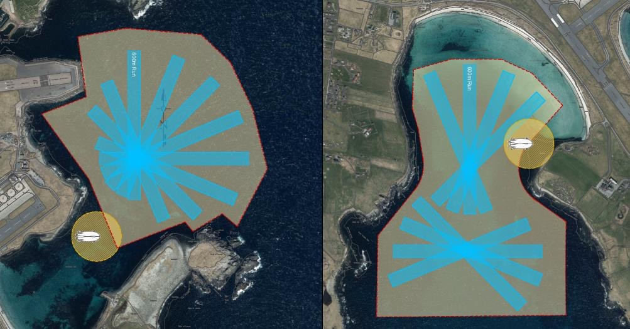
Water-landing capable
This document and the data it contains are the property of Hybrid Air Vehicles and may be confidential. They are subject to restrictions on their use. All use
other than that permitted in writing by Hybrid Air Vehicles is prohibited.

Slide 32
Principal conclusions - 2023 study with SATE partners
Large scale zero-emissions transport well in advance of other large aircraft
No operational impediments to operating at the airfields surveyed
In all cases, Airlander offers a versatile 10 tonne payload (approx. 100 pax or a mix of pax and cargo) into locations that mostly accommodate small aircraft only
On some sectors 13 tonne payload possible
Airfield adaptation costs very low
Demonstrates good weather-related availability. Weather effects are mostly small
Economics similar or better than existing regional aircraft
Potential to enhance capacity and to complement existing ferry and aircraft assets
This document and the data it contains are the property of Hybrid Air Vehicles and may be confidential. They are subject to restrictions on their use. All use
other than that permitted in writing by Hybrid Air Vehicles is prohibited.

Slide 33
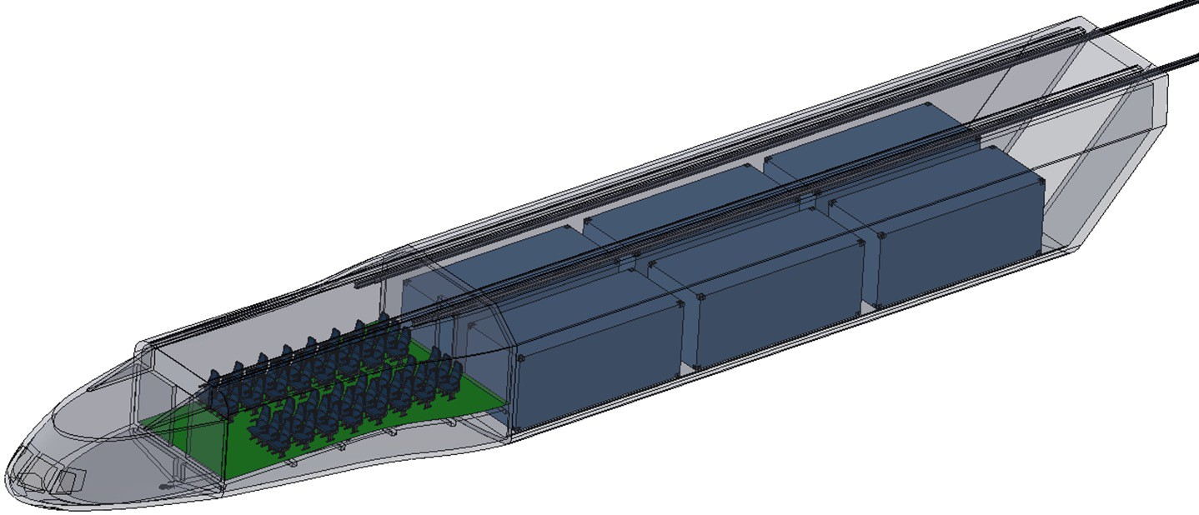

Airlander 50
Forward passenger / cargo bay
Seats up to 48 people or 10 tonnes of freight
10m long x 4m wide x 2.7m high
Flight deck
& Crew accommodation
Main cargo bay
Up to 6 x 20’ ISO containers and/or pallets and/or drive on vehicles and/or specialist ore concentrate receptacles for a maximum of 60 tonnes of freight
20m long x 5.2m wide x
3.8m high
Twin pilot operation and load master
Forward and main bay floor configured for freight movement/tie-down
Overhead gantry system (extending 10m to the rear of the module) with 2 cranes
Cranes have 7.5 tonnes capacity each or 10 tonnes combined
Full width rear cargo door, 2 x fwd 2m x 2m access doors
Main freight floor 1m above ground level for loading/unloading
Thiis document and the data iit contaiins are the property of Hybriid Aiir Vehiiclles and may be confiidentiiall.. They are subjject to restriictiions on theiir use.. Allll use
other than that permiitted iin wriitiing by Hybriid Aiir Vehiiclles iis prohiibiited..
11

Slide 34
Airlander
Freight and logistics
Highlands and Islands of Scotland

Slide 35
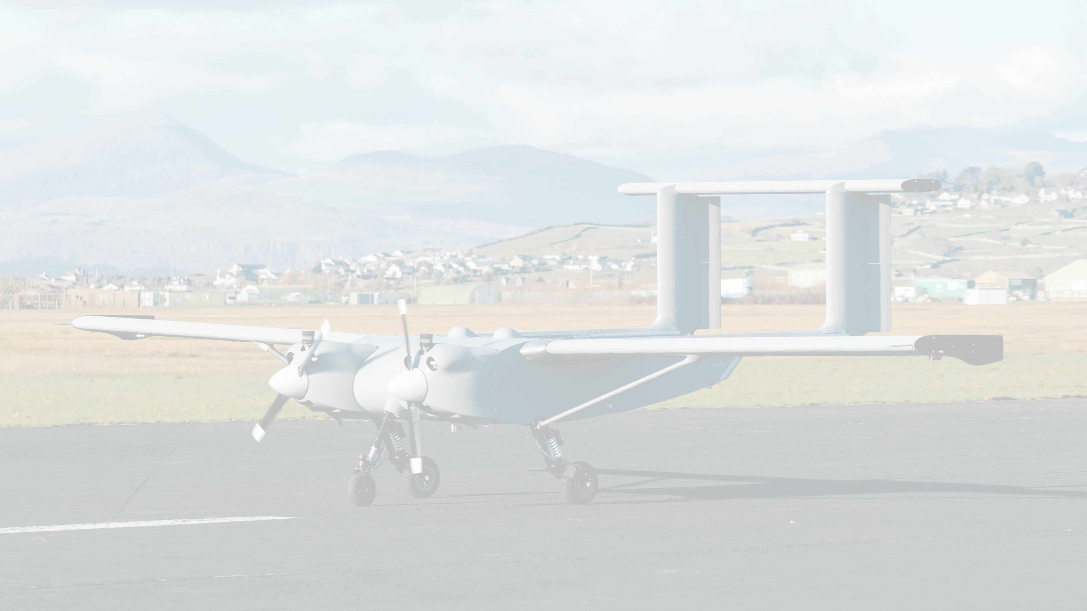

WINDRACERS
Self-flying heavy-lift aircraft
Strictly private and confidential
13

Slide 36
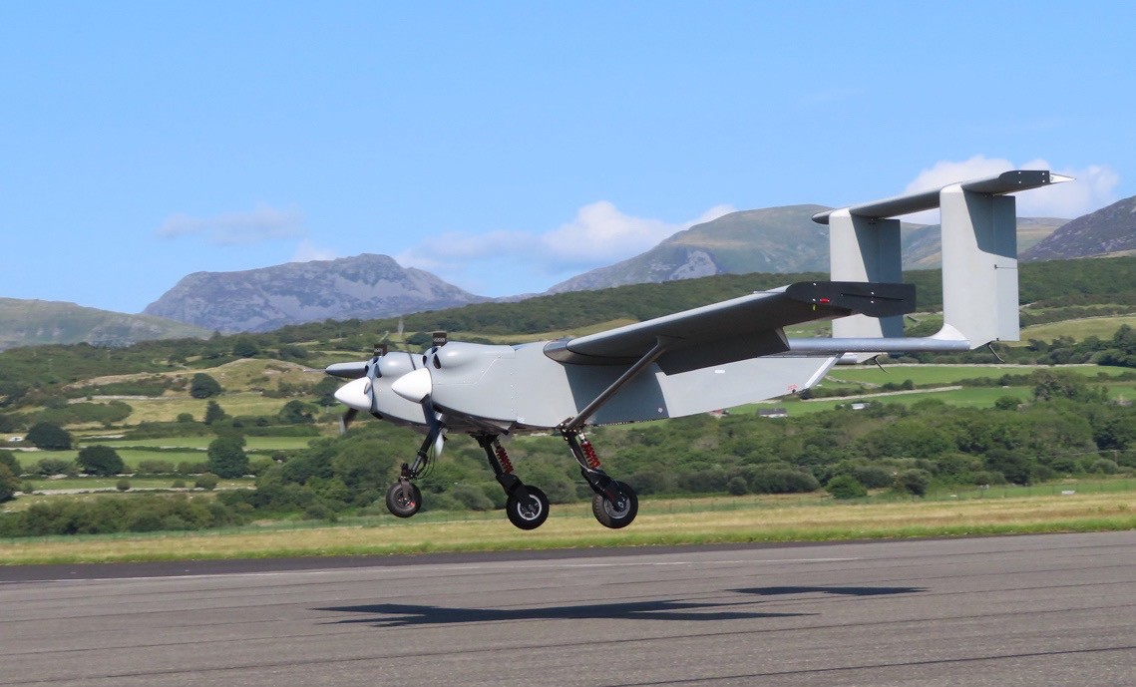
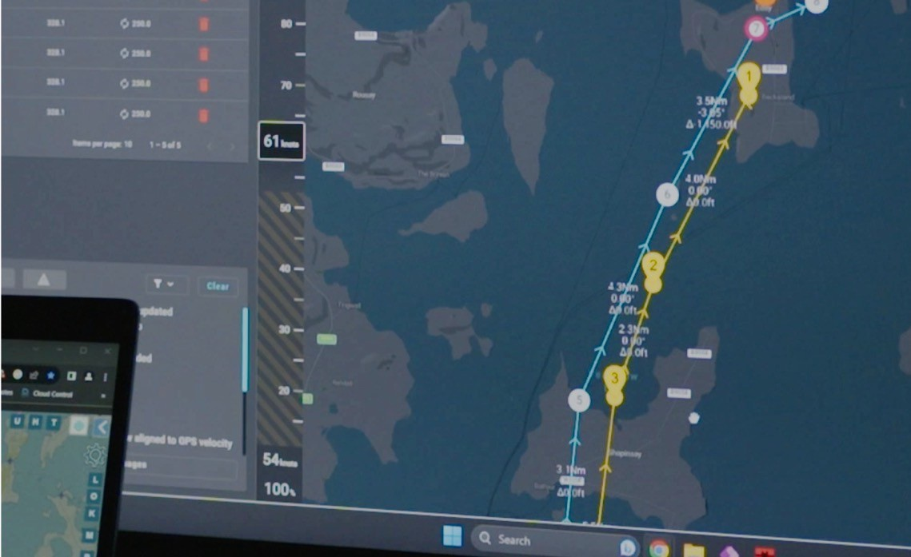

WINDRACERS: Low-Cost & High Dependability platform
Low-Cost
Cheap – less cost for the same offer
Dependability
Trustworthy & Reliable
ULTRA: Uncrewed Low-cost TRAnsport
The Jeep of the skies
MASTERLESS
Autopilot: No-pilot from ‘take-off to landing”
Zero single point of failure philosophy
Strictly private and confidential

Slide 37






Our Sectors
Detect
Drop
Deliver
Strictly private and confidential

Slide 38
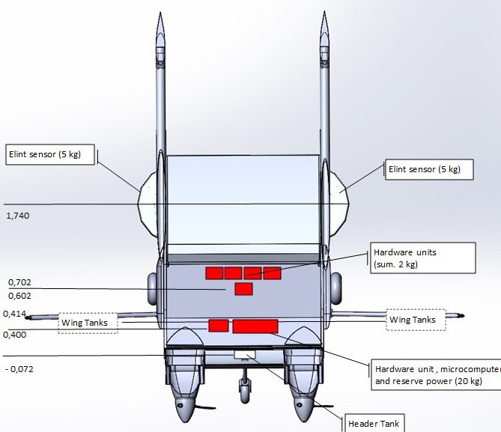
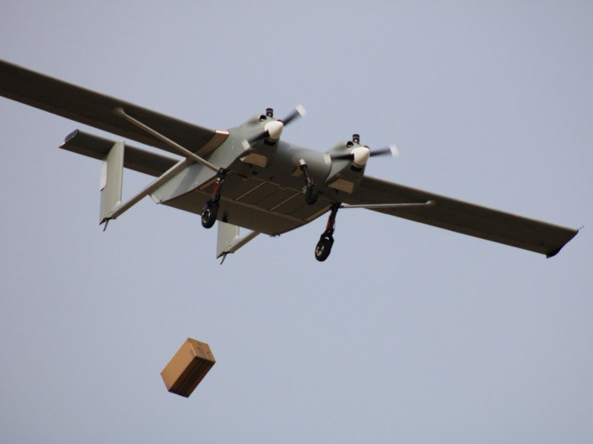

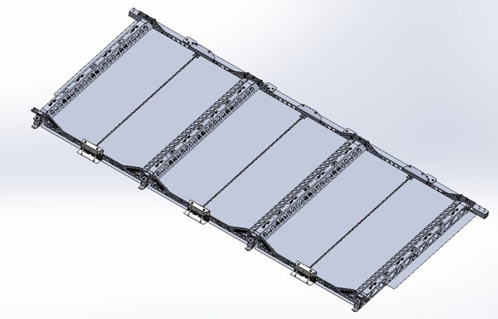






Use cases: detect, drop, deliver
Detect
Drop
‘Drop Doors’
x3 compartments with/without parachute
Deliver
Royal Navy: Aircraft drone makes history landing on Royal Navy carrier at sea
‘ELINT’
Electronic Intelligence
Captain Richard Hewitt, Commanding Officer HMS Prince of Wales said: “HMS Prince of Wales is a fifth-generation aircraft carrier and operating autonomous drones like this will become the norm across future Royal Navy Carrier Strike Groups in our 50- year lifespan.”
Same use case:
Same use case:
Same use case:
Strictly private and confidential

Slide 39
Where’s the interest?
Aerial surveillance
  Wind farms
  Ecological
  Antarctica
Humanitarian aid
  WFP – Africa
Sampling deliveries
  Olympics
  Water
Mail / Parcel & Medical
  Remote locations
Strictly private and confidential

Slide 40
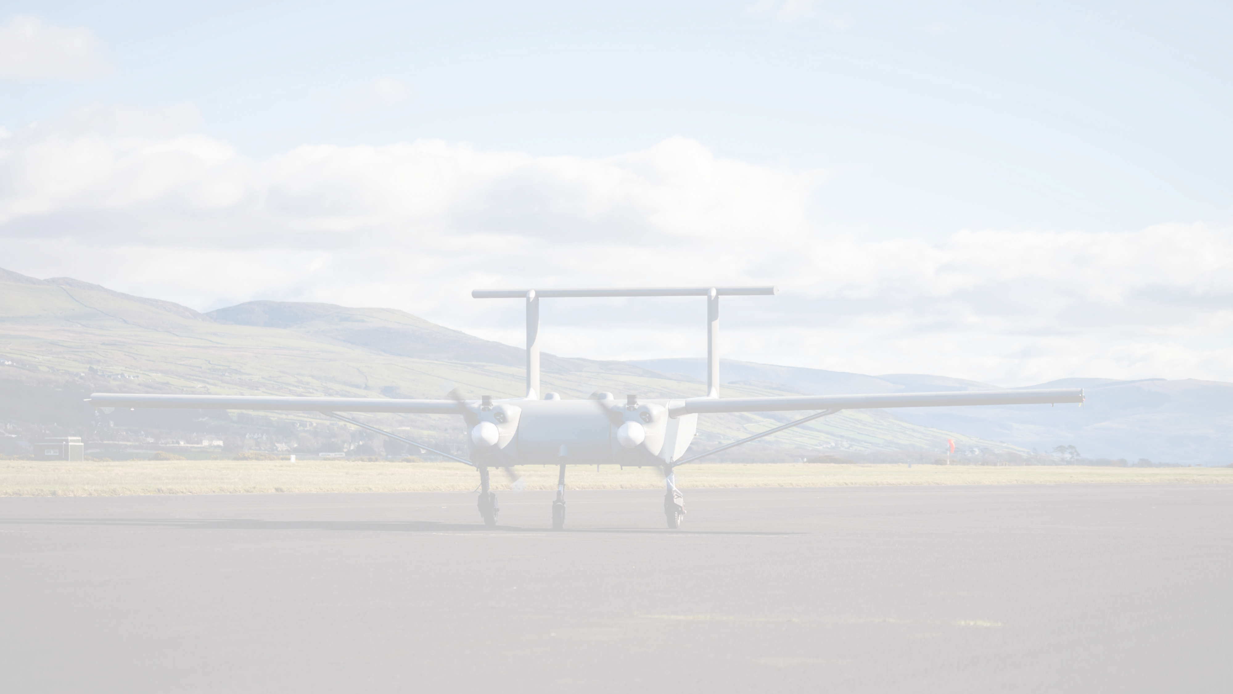
Strictly private and confidential

Slide 41


Proud to partner with:
Strictly private and confidential

Slide 42
Towards Zero Emission HVGs – a call to action from Transport Scotland

Slide 43
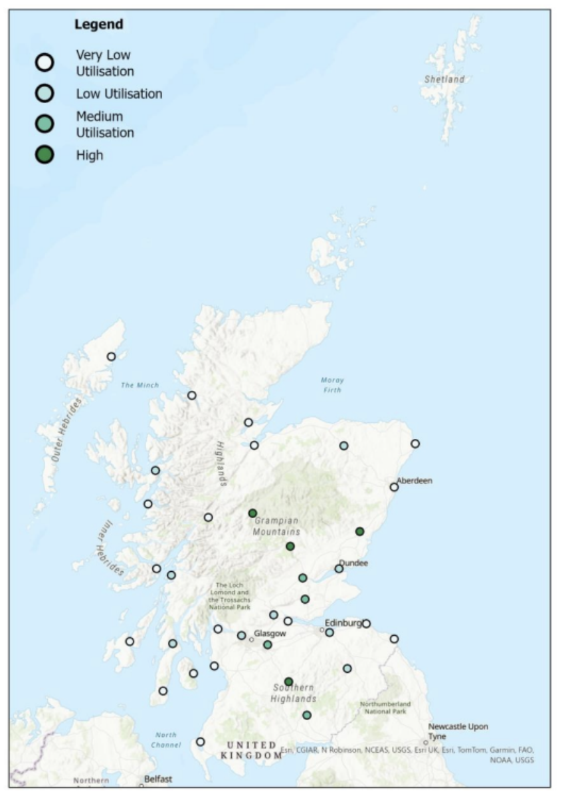
Transport Scotland has recently published initial research on where en route charging and fuelling for zero emission HGVs will be needed: Towards Zero Emission HGV Infrastructure in Scotland
Modelling of sites based on data is shown on the map
Around 1% of Scottish HGVs are currently represented – can we get more?
What data is needed?
At its simplest we want to know the start and end points of the journeys trucks take and when they travel these routes
Heriot-Watt University are doing the work and have comprehensive data security arrangements as data is commercially sensitive
Any interested fleets or bodies with relevant data should contact
cls-info@hw.ac.uk or karen.geekie@gov.scot.

Slide 44
DATE OF NEXT MEETING
To be confirmed

